Slide 1

Solar cell materials:
simulation, optical and photoelectric characterization
Prof. Serhiy KONDRATENKO
Department of Optics, Faculty of Physics, Taras Shevchenko National University of Kyiv
Prof. Oleg OLIKH
General Physics Department, Faculty of Physics, Taras Shevchenko National University of Kyiv
1st Workshop Green Energy Technologies for the Future

Slide 2

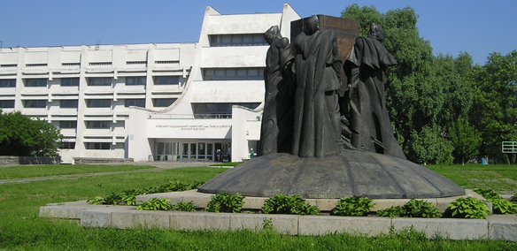


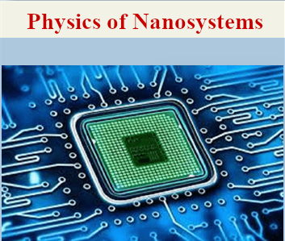
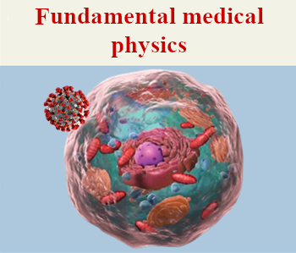
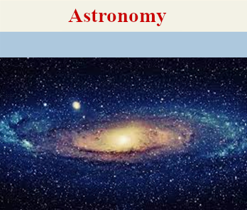
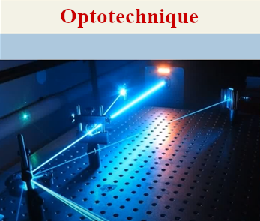
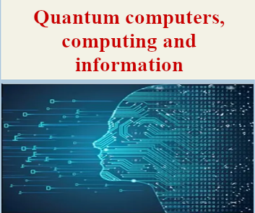
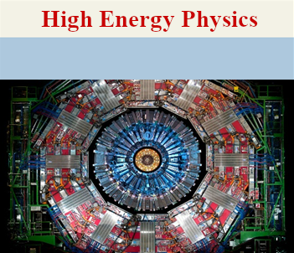

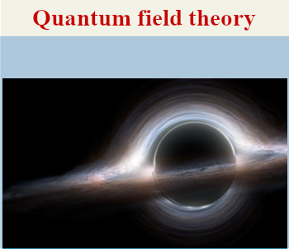
500 students
80 lecturers
140 researchers

Slide 3
EDUCATION
Master’s program “Physics of Nanosystems”
Selected courses:
Nanoelectronics
Physical properties of nanosystems
Theory and modelling of nanostructures
Physics of semiconductor heterostructures
Theory of nanocomposites
Physics of carbon nanocomposites
Modern problems in physics of nanosystems
Opportunities for students:
Various types of educational internships
Laboratory work
Participation in research projects
Academic mobility

Slide 4
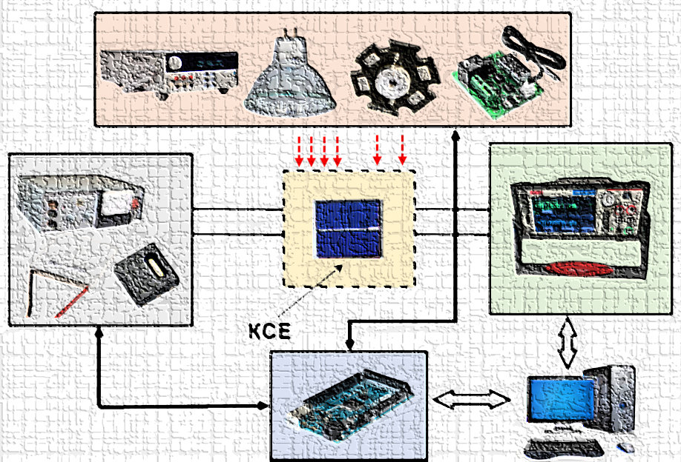
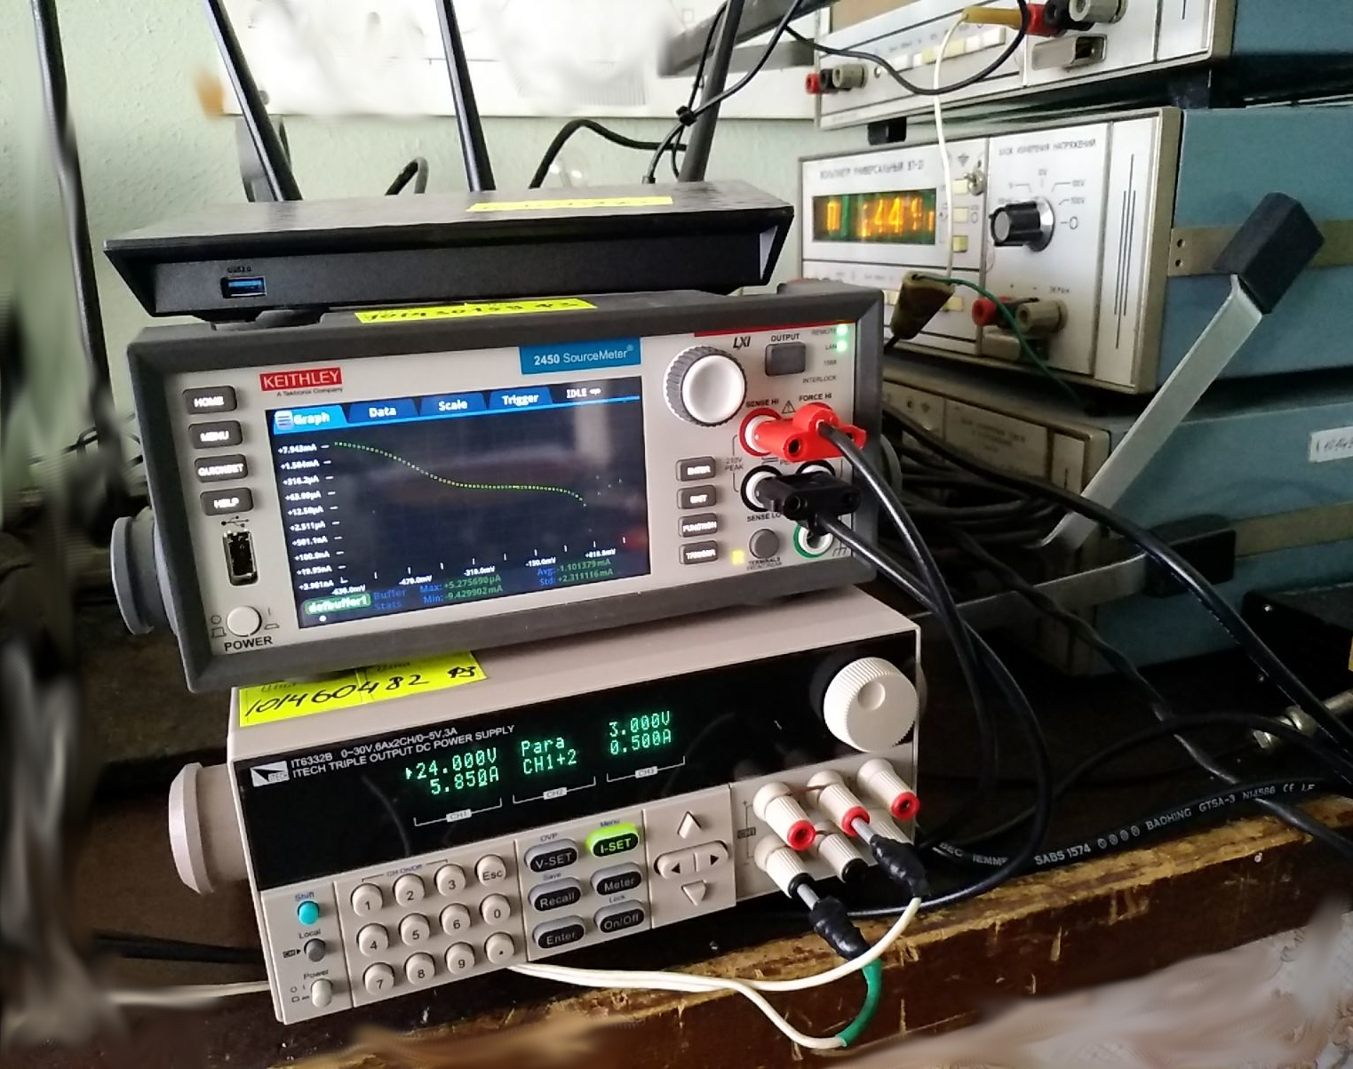
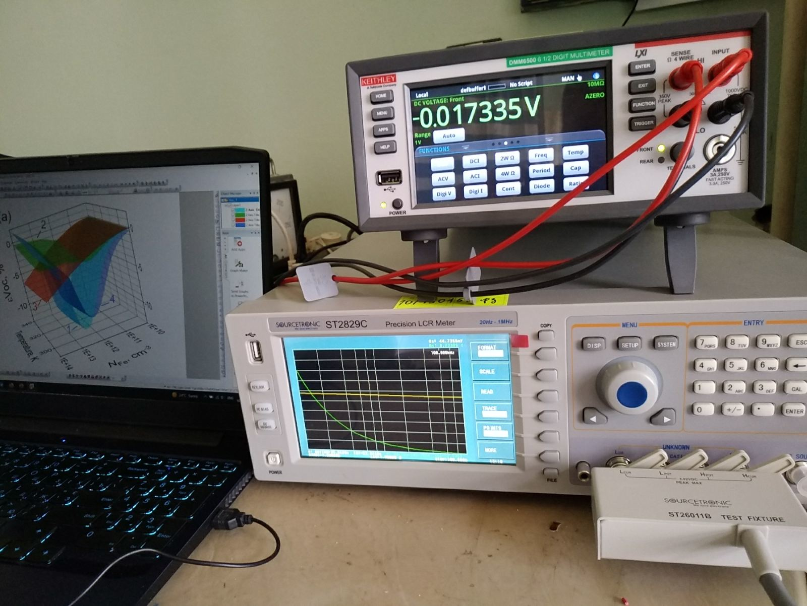
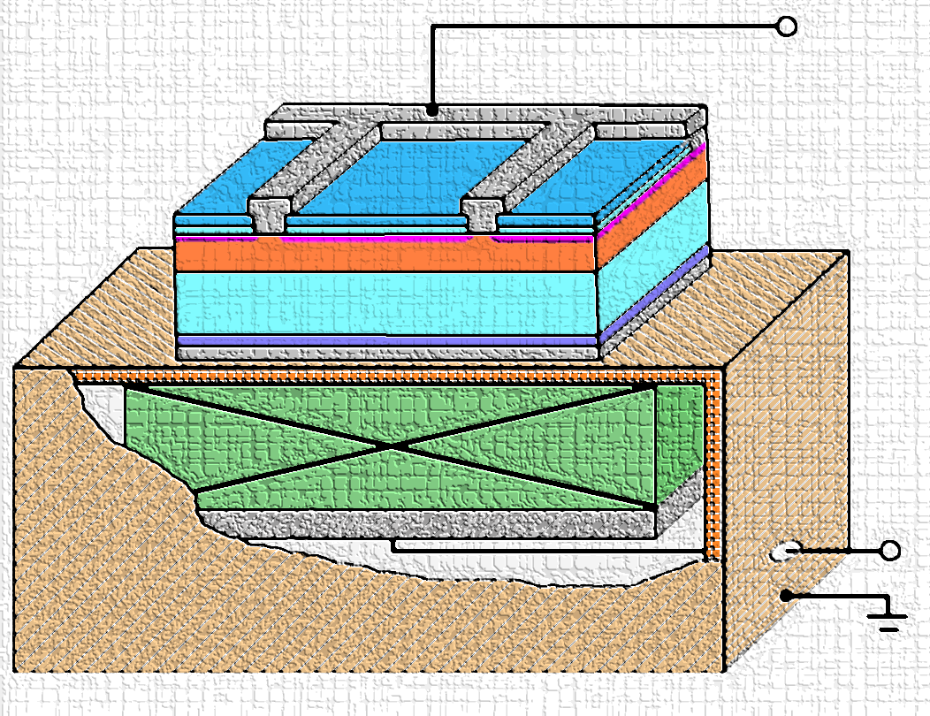
SCIENTIFIC RESEARCH
1. Experimental investigations of semiconductor structures for thermoelectrics and solar cells
Current-voltage measurement of solar cells (20 mV – 200 V, 10 nA – 1 A, 150 – 350 K)
Capacitance-voltage measurements of semiconductor barrier structures (20 Hz – 1MHz, 1fF – 10 F, 5mV – 10 V)
Determination of semiconductor structures’ parameters under ultrasound action (100 kHz – 30 MHz, transverse and longitudinal waves)

Slide 5
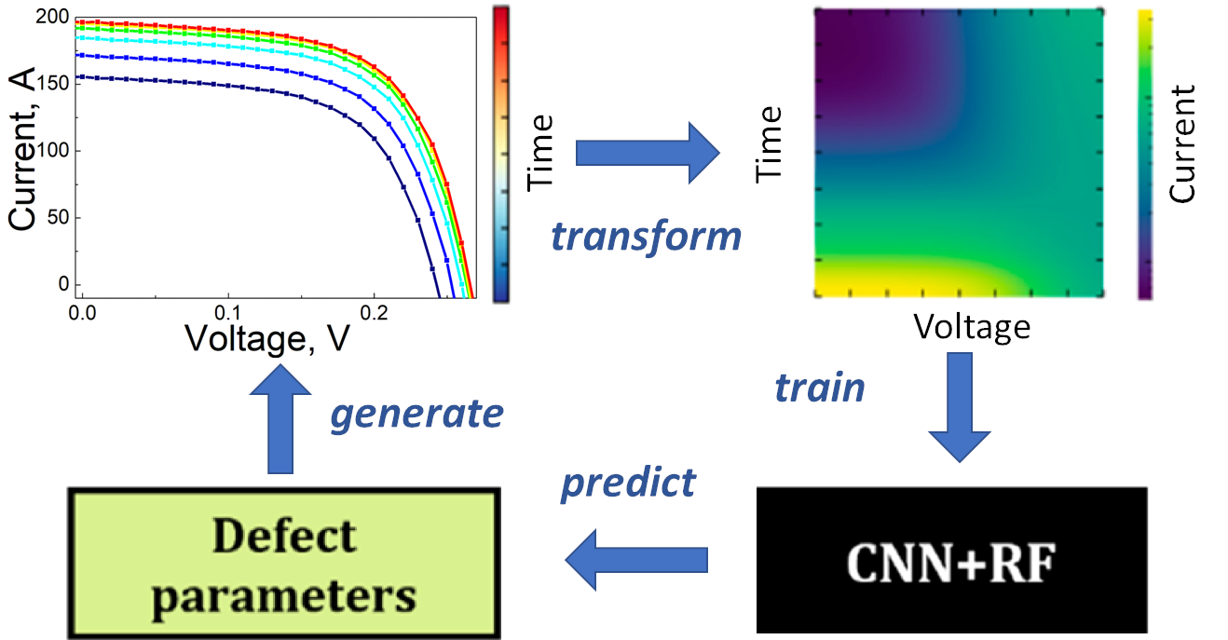
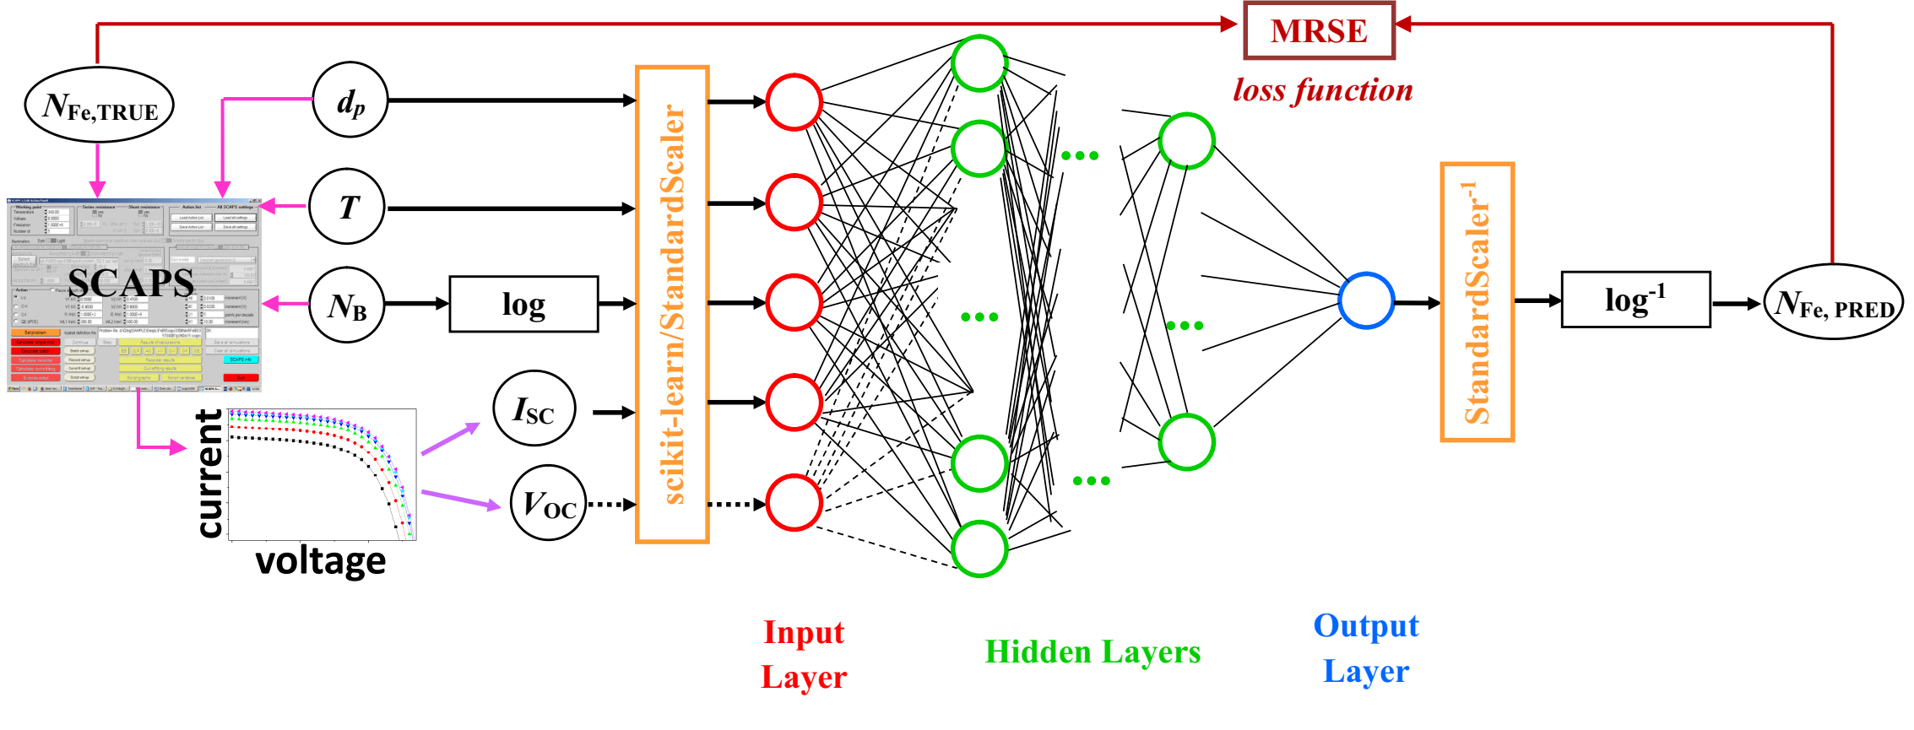
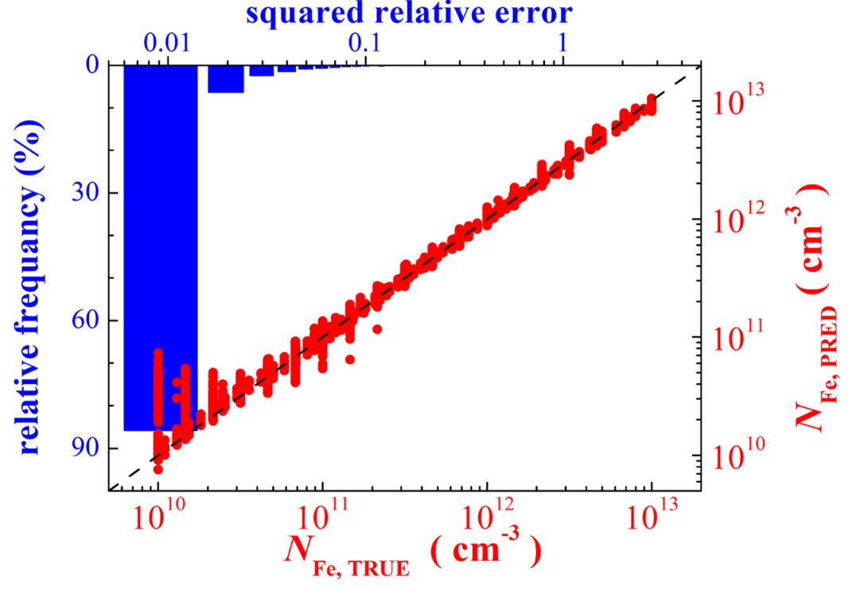
SCIENTIFIC RESEARCH
2. Using machine learning for estimation of defect contamination in solar cells
Simulation of photovoltaic structures for labeled dataset preparation
Exploring, teaching, and tunning machine learning algorithms
Testing of developed models on actual silicon solar cells

Slide 6
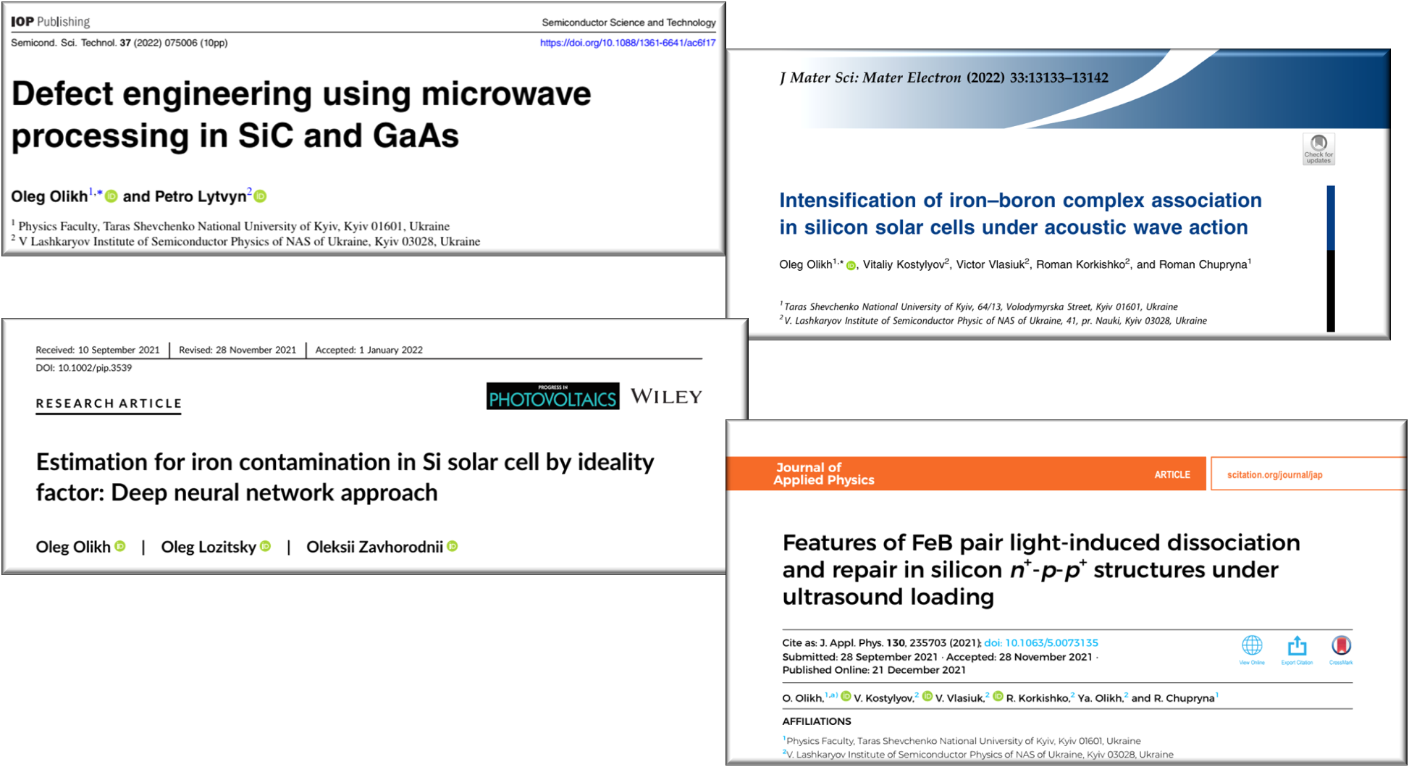

Slide 7
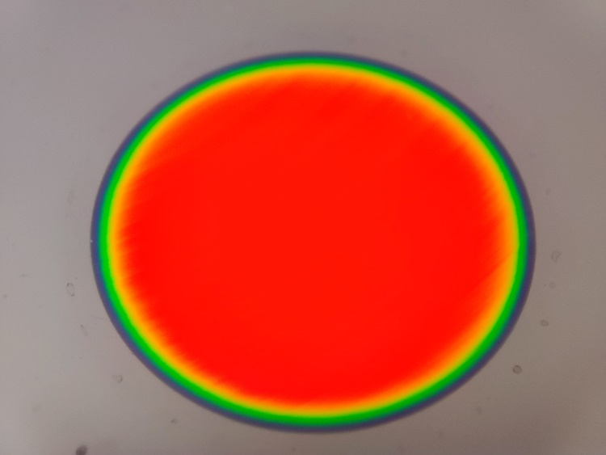
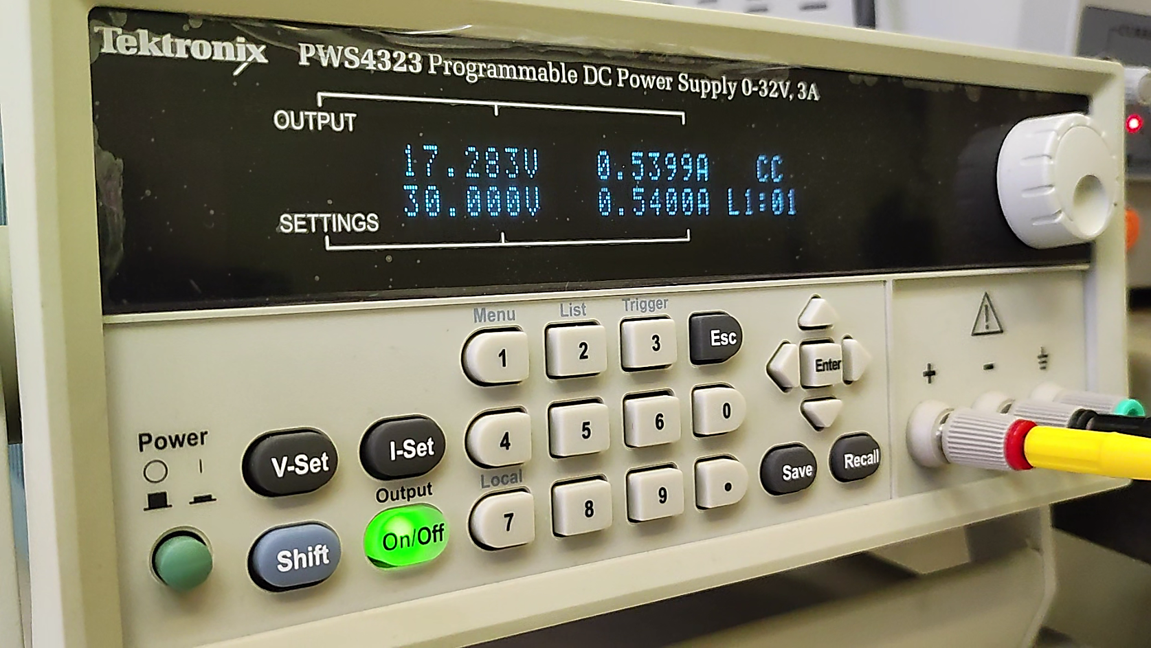
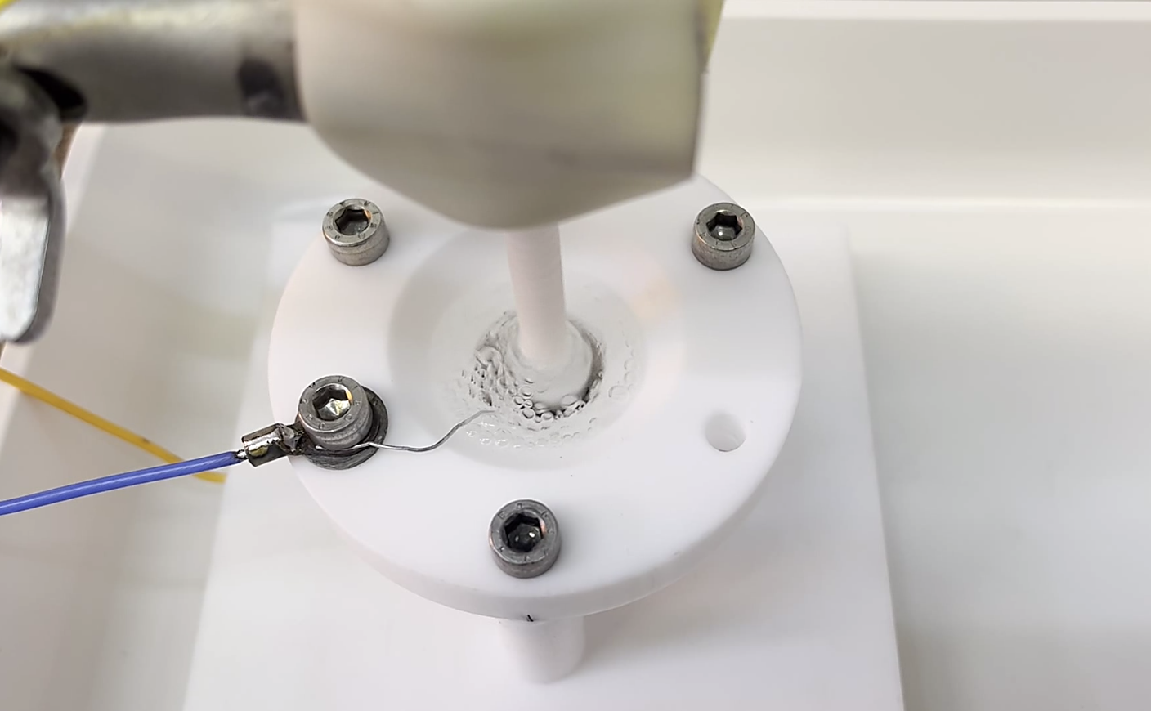
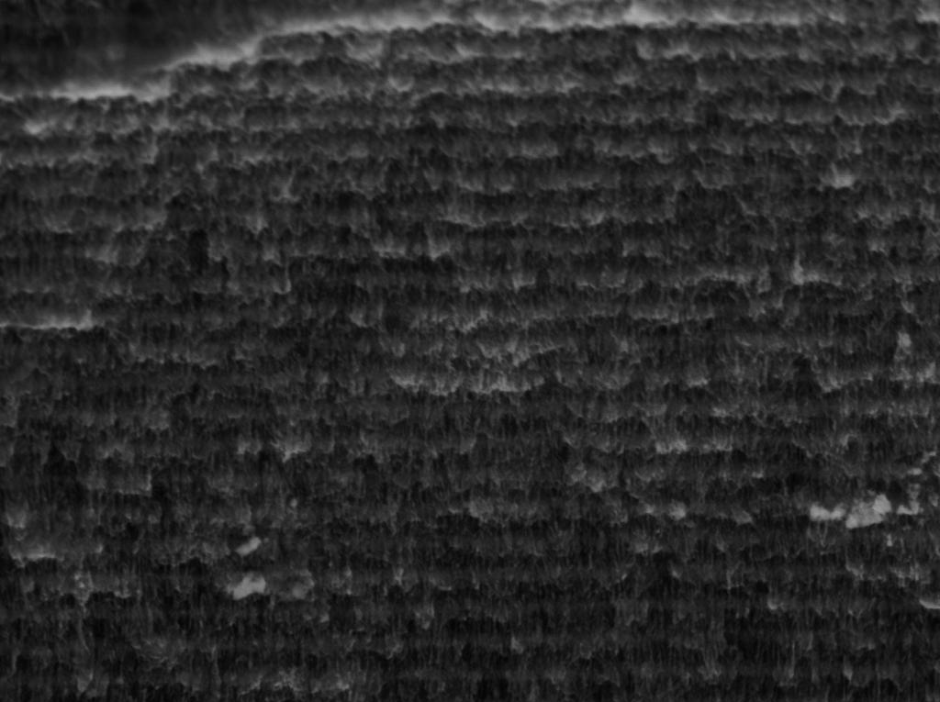
SCIENTIFIC RESEARCH
3. Synthesis of silicon multilayer porous structures and investigation of their structure, optical, and thermal properties
Electro-chemical etching of multilayer porous silicon
Gravimetry, Optical and scanning electron microscopy
Spectroscopic optical techniques

Slide 8
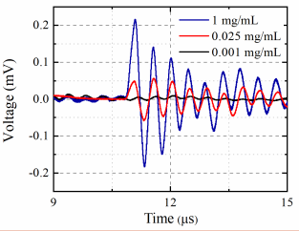
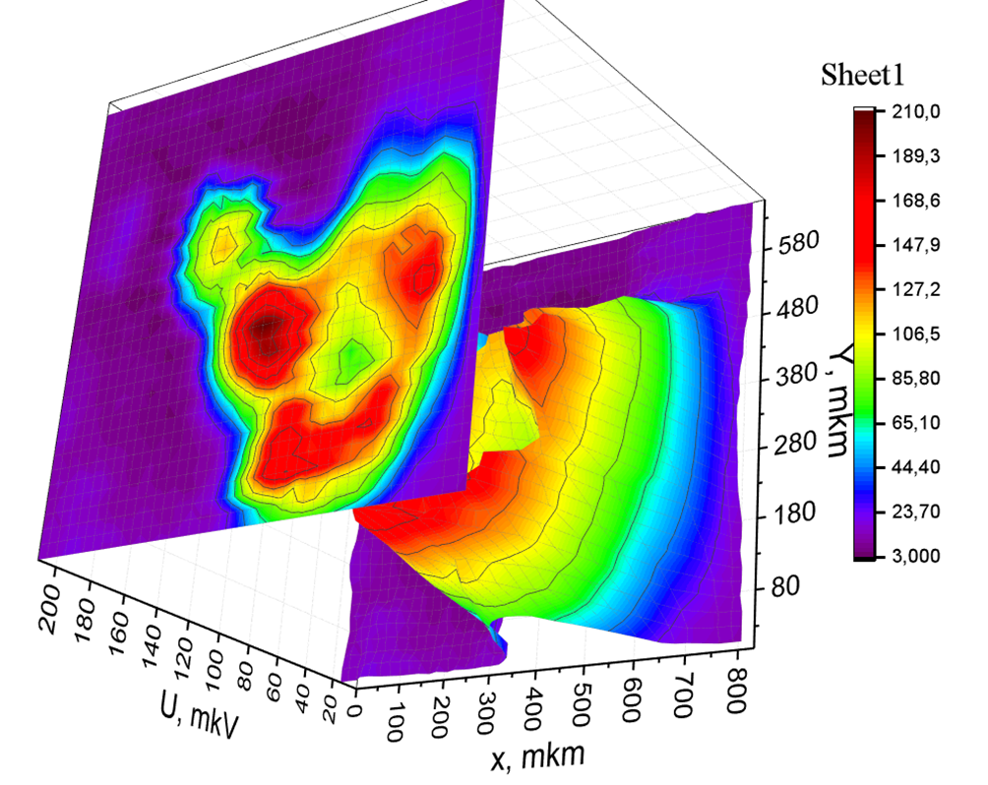
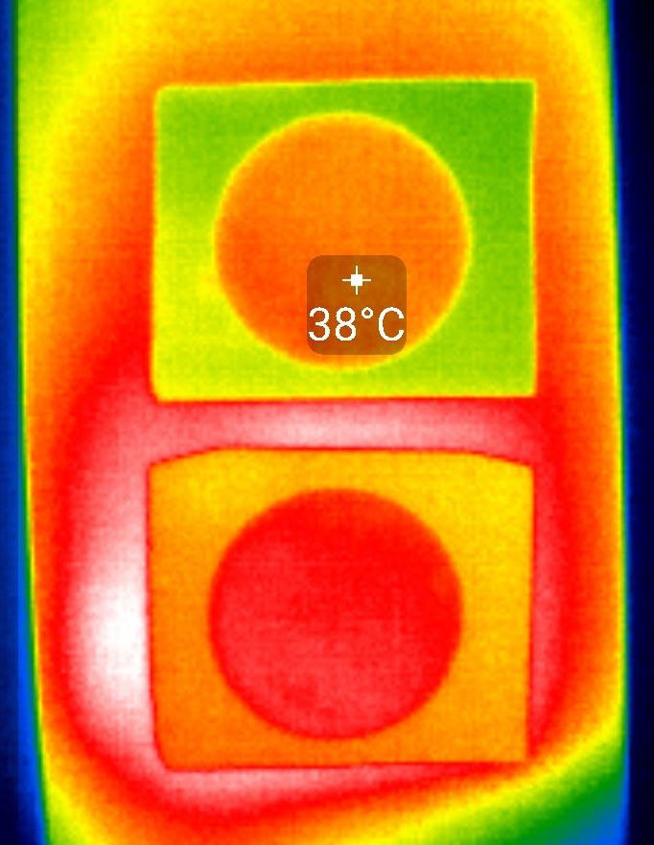
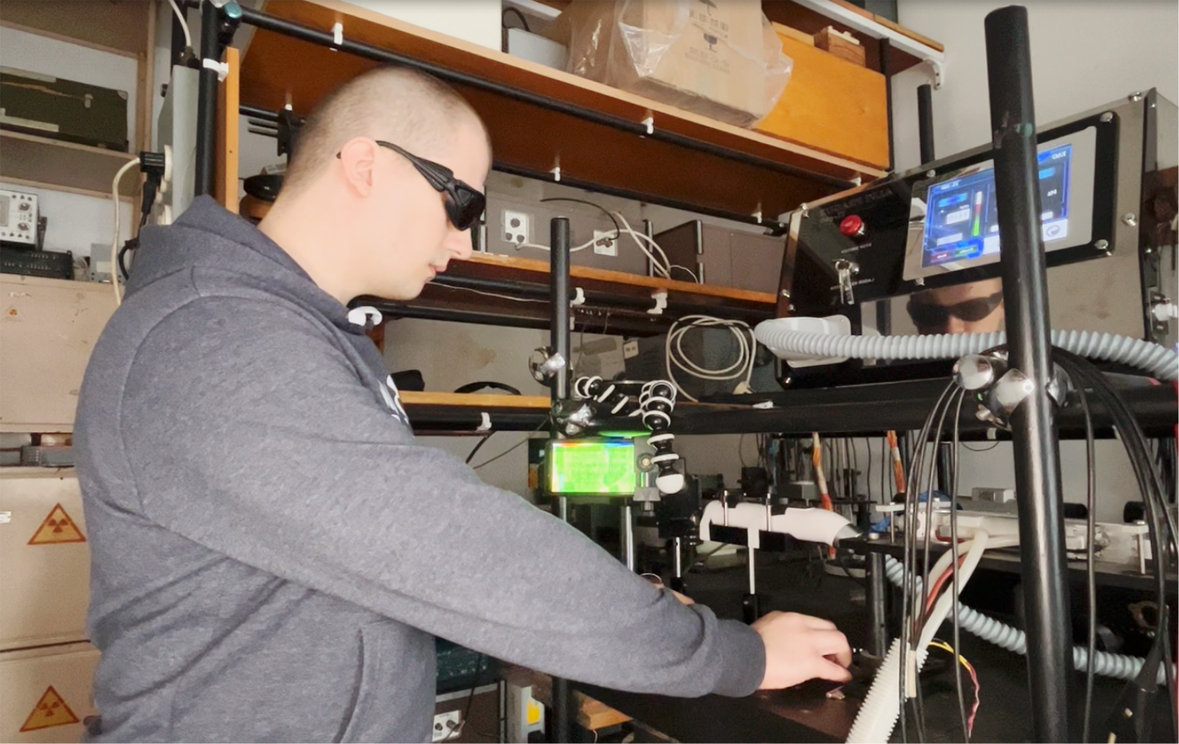
SCIENTIFIC RESEARCH
3. Synthesis of silicon multilayer porous structures and investigation of their structure, optical, and thermal properties
Photoacoustic and Photothermal techniques :
amplitude-frequency and phase-frequency responses
time and temperature dependent response of informative signal
photoacoustic and photothermal imaging
thermal diffusivity and thermal conductivity parameters

Slide 9
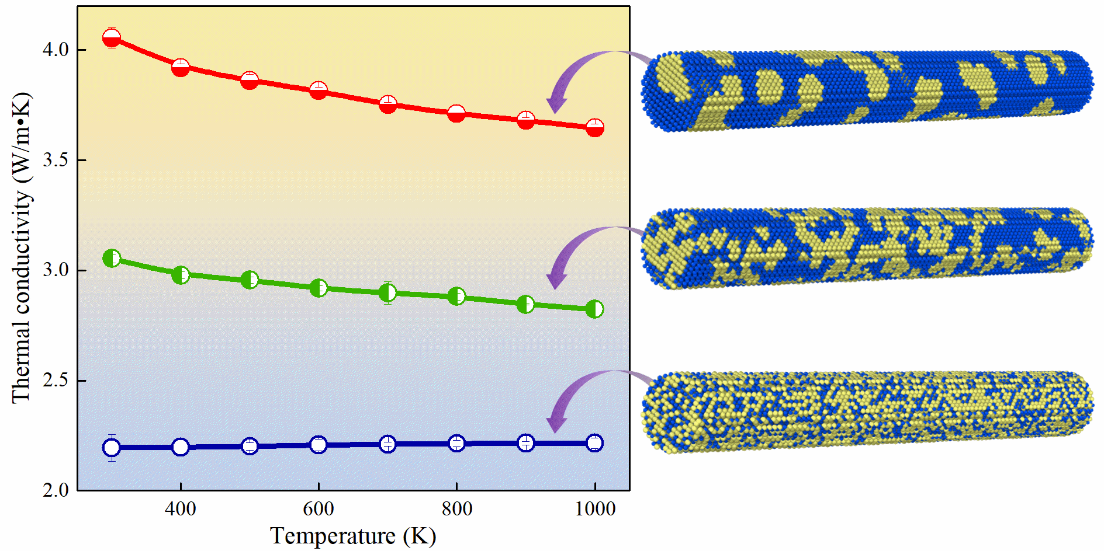
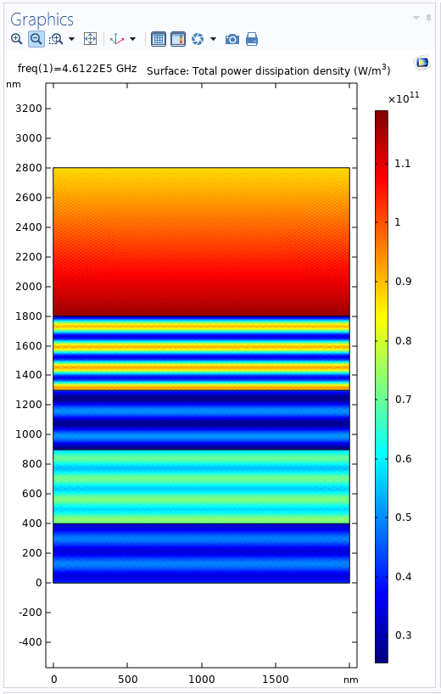
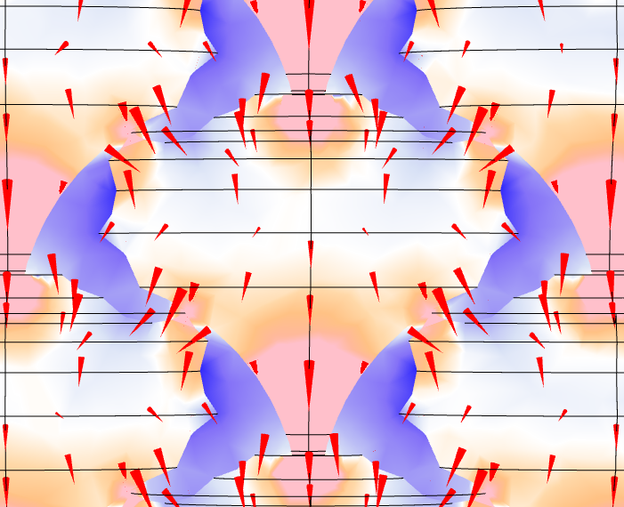
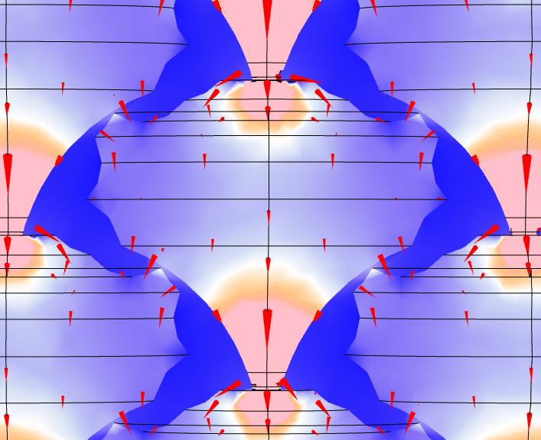
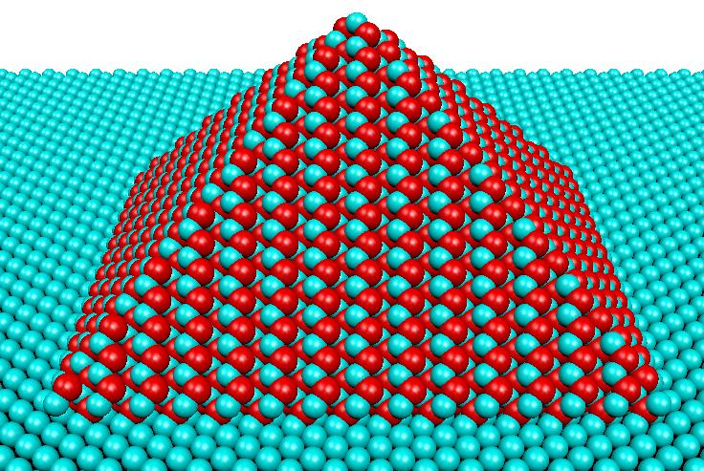
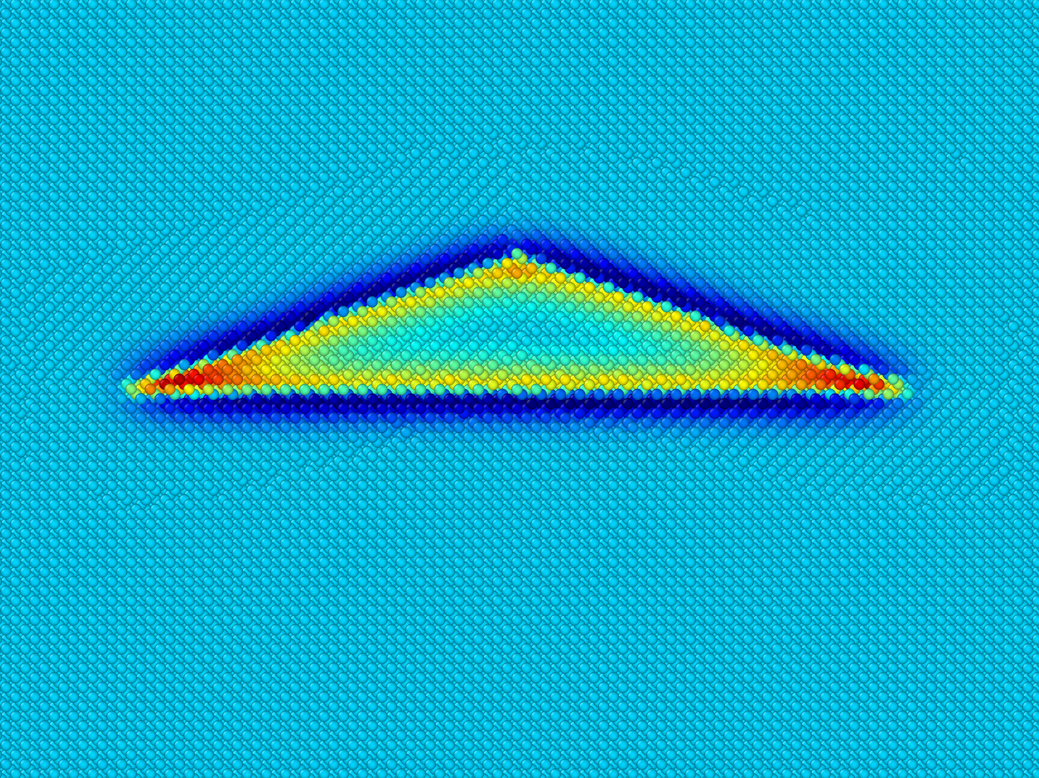
SCIENTIFIC RESEARCH
4. Modeling of phonon transport properties of nanostructures for thermal management and thermoelectric applications
Molecular dynamics simulation of thermal conductivity of semiconductor nanostructures
Anharmonic lattice dynamics
Analytical modeling of phonon transport in nanostructures
Finite element modeling of thermal phenomena in materials

Slide 10
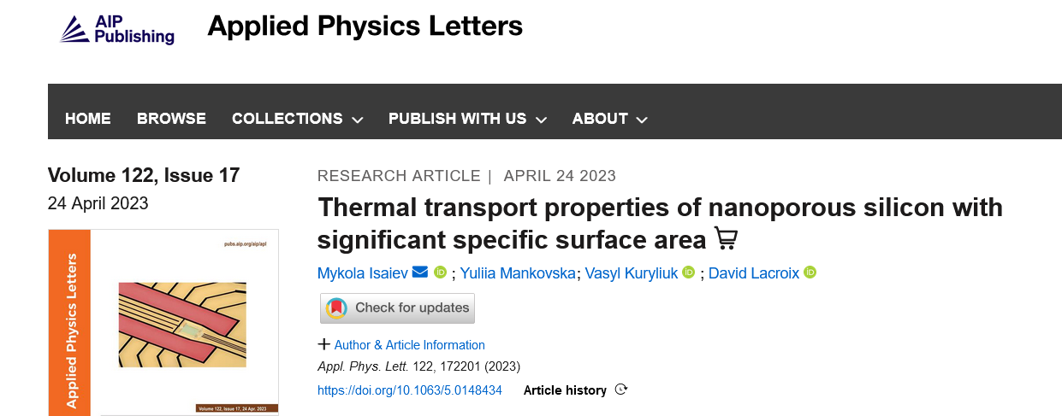
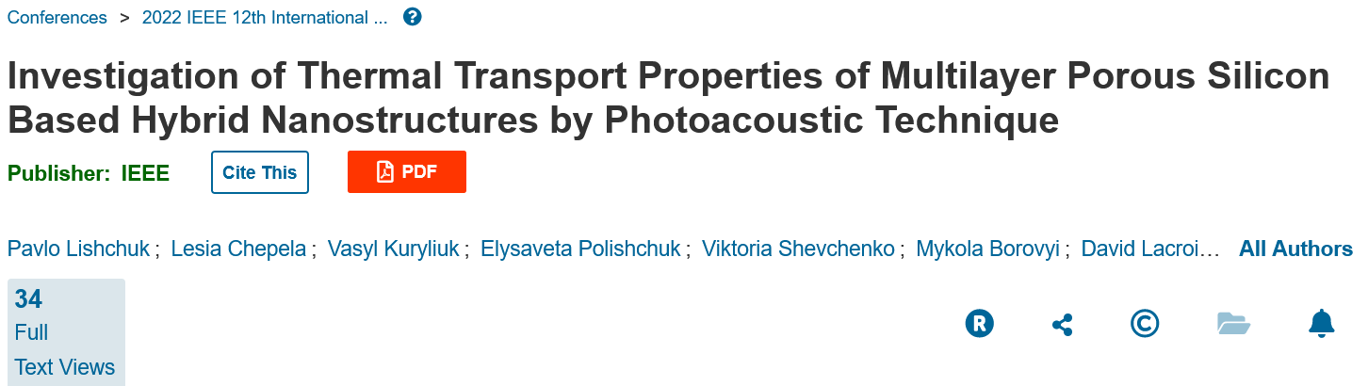
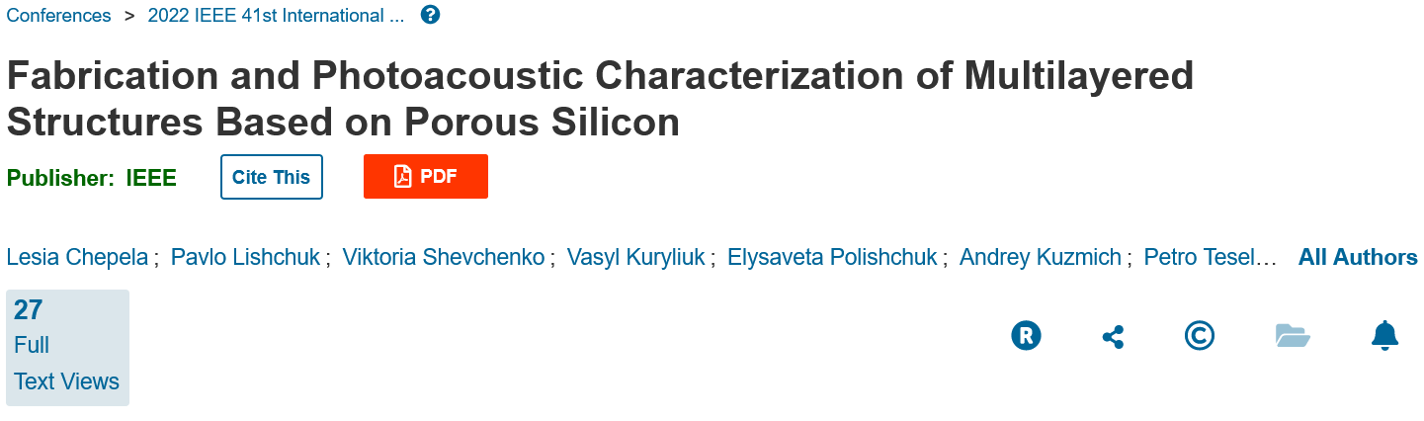
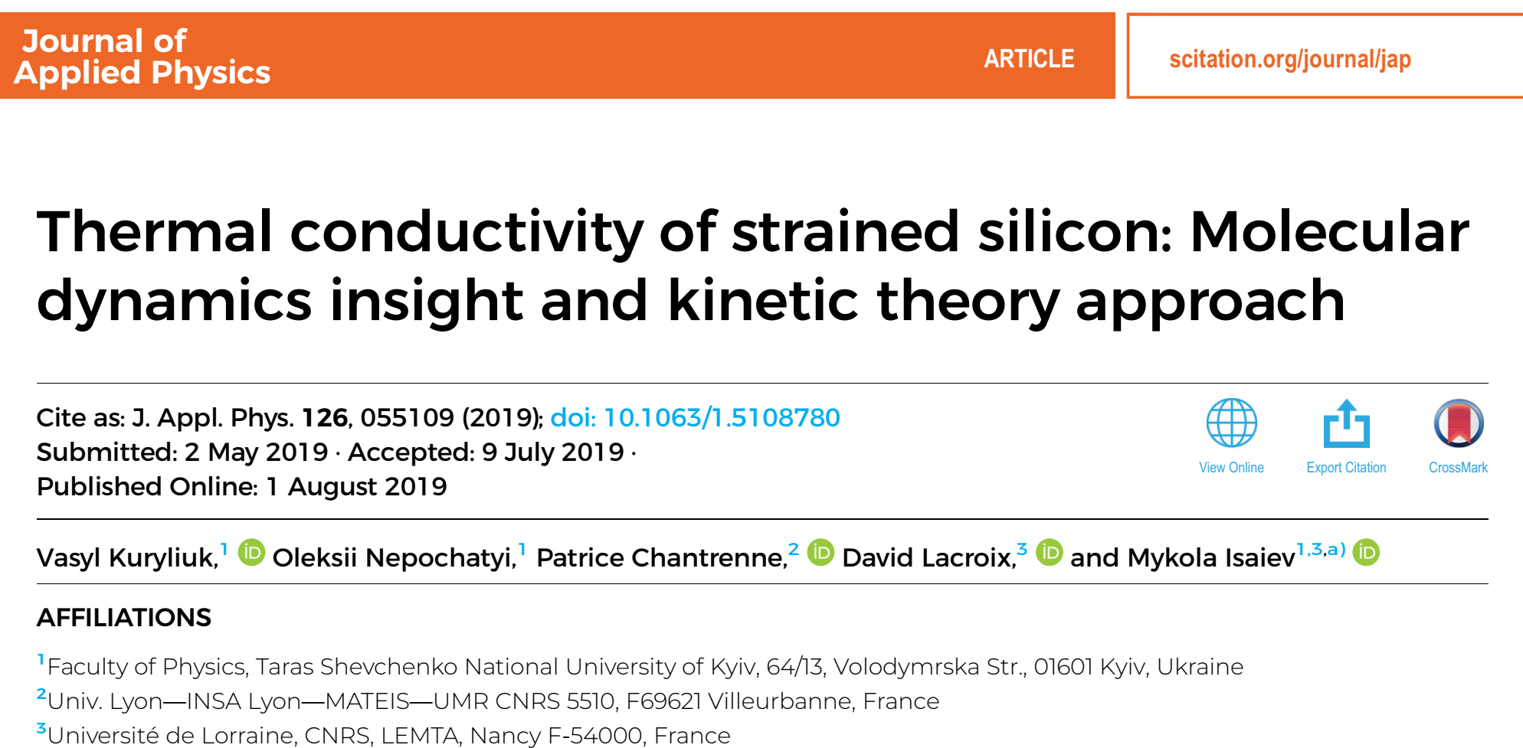

Slide 11
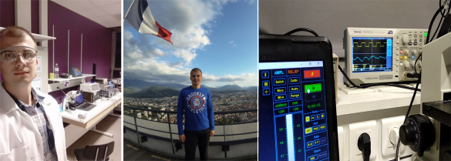
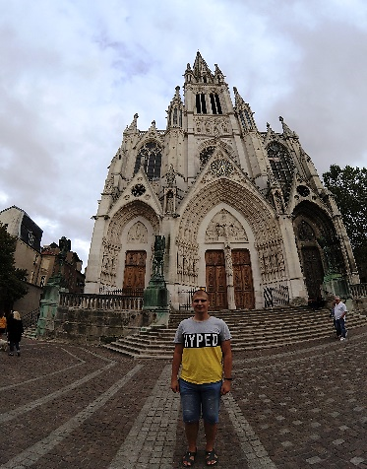
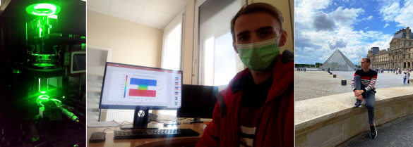
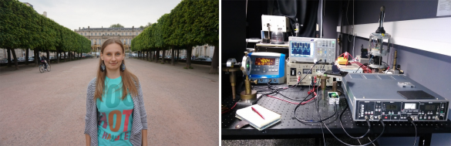
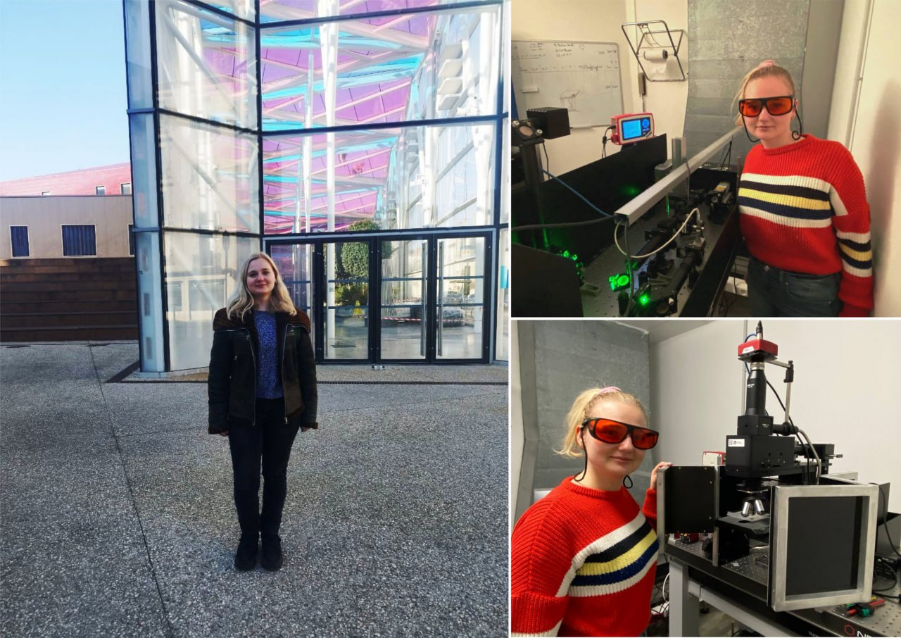
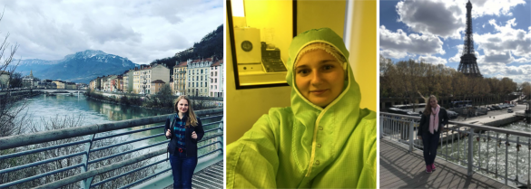
EXCHANGE OF SCIENTIFIC EXPERIENCE
PAVLO LISHCHUK: joint experimental research on thermal transport in semiconductor structures (2017-2019).
VIKTOR MANDROLKO during academic mobility within the Erasmus+ program (2021-2022)
KATERYNA DUBYK: experimental research on colloidal solutions of nanoparticles with varying content of carbon materials (2016, 2017).
LESIA CHEPELA during academic mobility within the Erasmus+ program (2019, 2023).

Slide 12
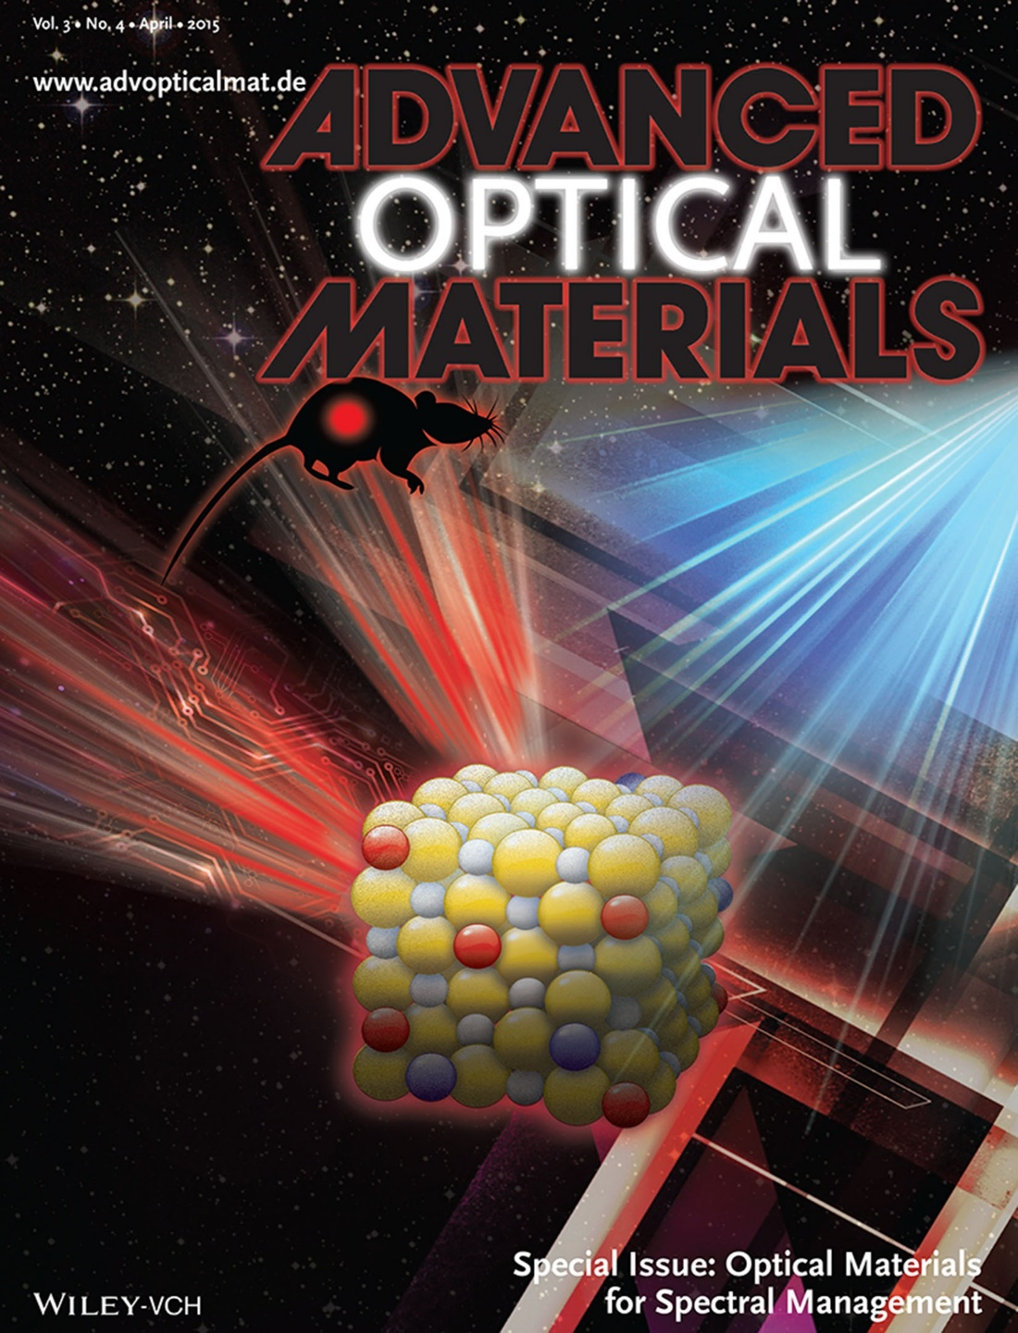
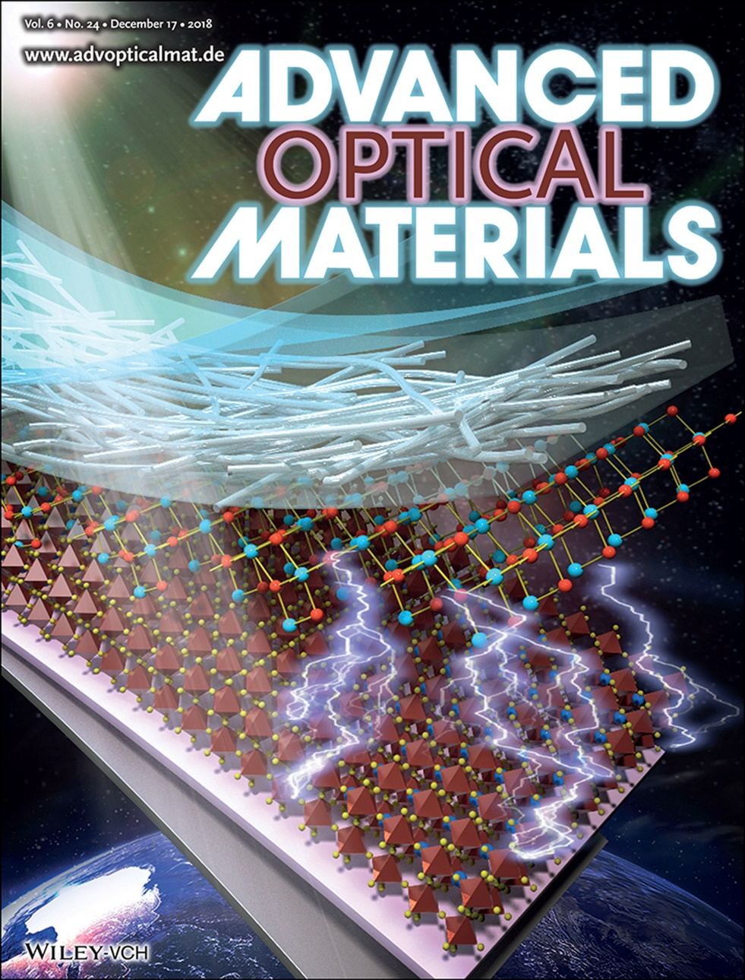
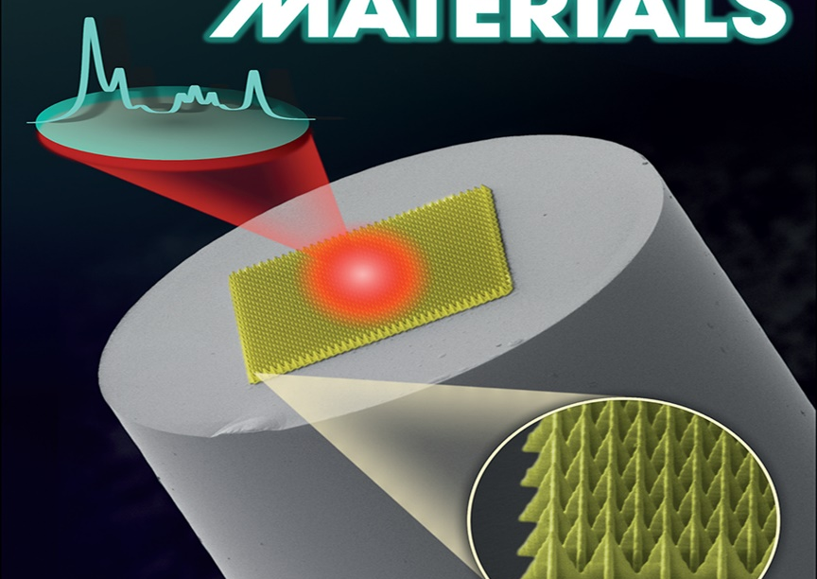
Group of Optical diagnostics of semiconductor materials
Prof. Serhiy Kondratenko
1st Workshop Green Energy Technologies for the Future

Slide 13
EDUCATION
Master’s program “Optics and laser physics”
Selected courses:
Nanoelectronics
Photovoltaics
Optical diagnostics of Semiconductors
Solis State Physics
Bachelor’s program “Optics”
Selected courses:
Semiconductor Optics
Electronics
Laser Physics
X-ray and UV Optics

Slide 14
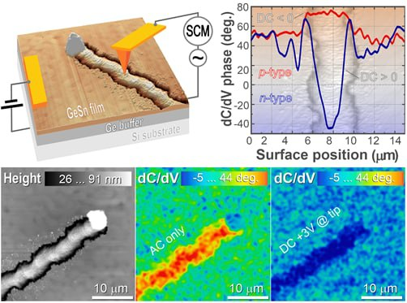
Group Research topics
Solar cells and IR Photodetectors
Physics of Low-Dimensional Systems
Photoconductivity of Semiconductor Heterostructures
1st Workshop Green Energy Technologies for the Future

Slide 15
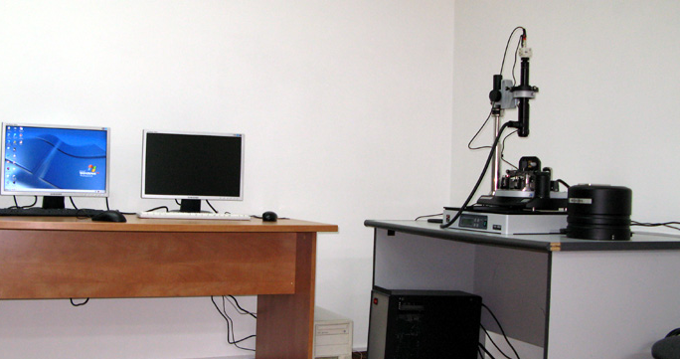
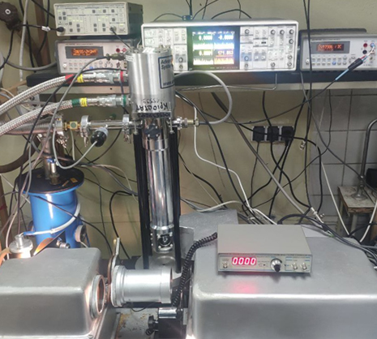
Experimental facilities
Semiconductor characterization setup
AFM and Kelvin Probe Force Microscopy
Photoelectric and Photoluminescence spectroscopy
Photoconductivity transients and thermally stimulated conductivity
Transport measurements
Temperature range:
10-400K
Spectral range
0.25-10 μm
pA low current sensitivity
Lock-in amplifier low noise detection
Sample preparation and other characterization facilities
Spin and spray coating thin film deposition
Spectral ellipsometry
Optical transmission and absorption spectroscopy
1st Workshop Green Energy Technologies for the Future

Slide 16
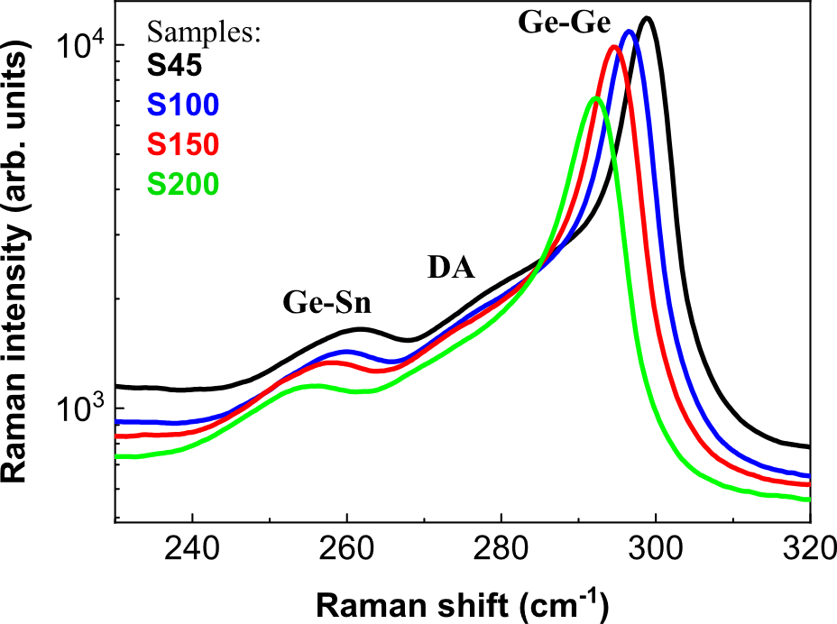
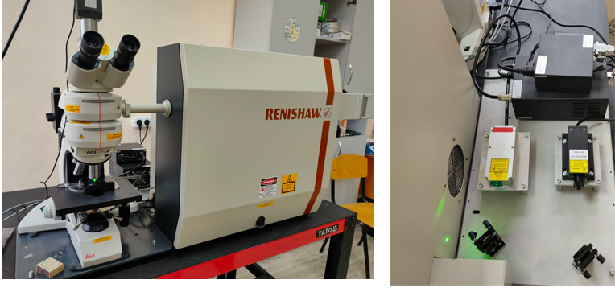
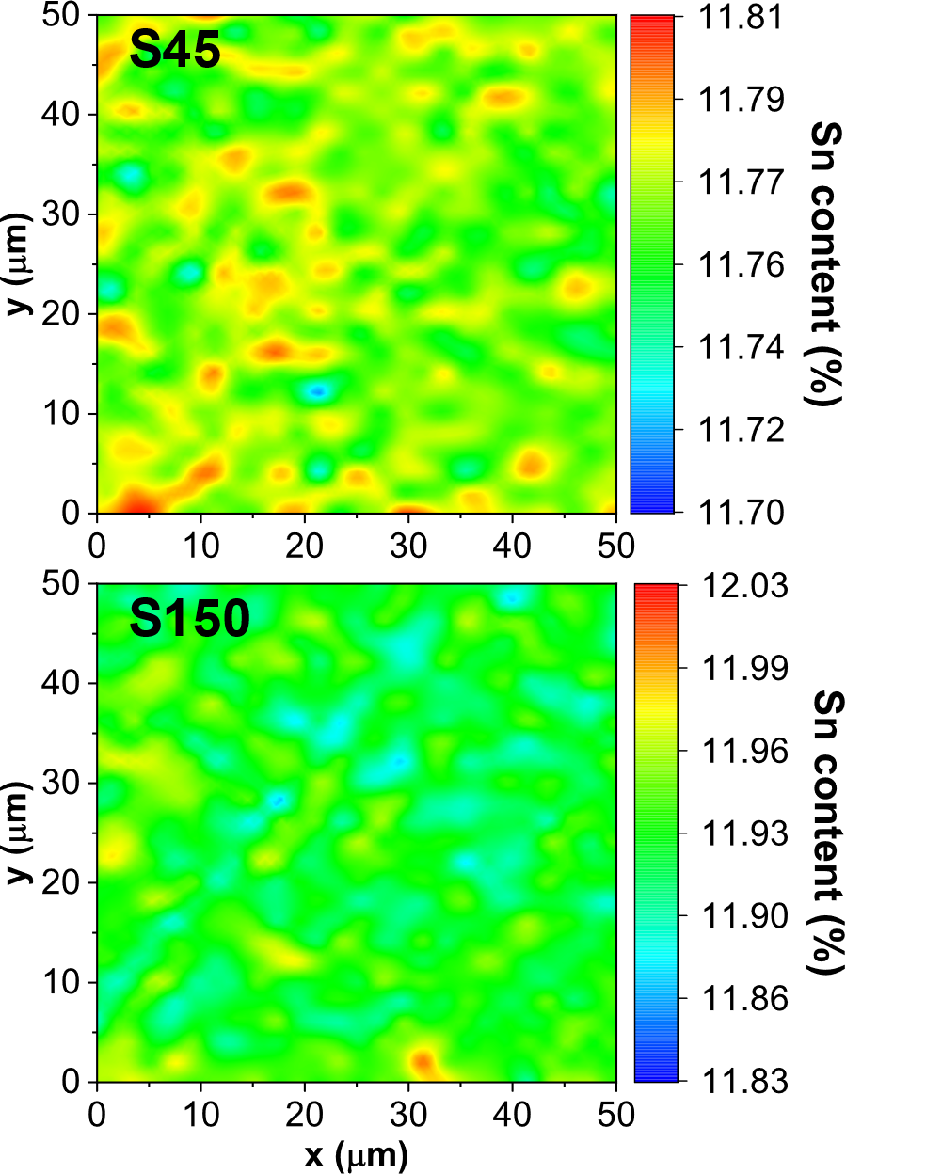
Optical diagnostics of solar cell materials
Raman Spectroscopy
1st Workshop Green Energy Technologies for the Future

Slide 17
Ongoing projects
Innovative Solar Cells NATO project (2021-2025)
in collaboration with
Lashkaryov Institute of Semiconductor Physics NASU (ISP NASU), Kyiv, Ukraine (Prof. Dr. Alexei Nazarov)
Université catholique de Louvain, Louvain-la-Neuve, Belgium (Prof. Dr. Denis Flandre)
Development of advanced thin film optoelectronic materials based on coupled
hybrids of quantum dot and two-dimensional nanostructures
National Research Foundation of Ukraine (2020-2023)
Completed project
GeSn alloys for improved current generation and charge carrier collection in tandem solar cell
CRDF Global (2020-2021)
in collaboration with Arkansas Institute for Nanoscience and Engineering, University of Arkansas
(Prof. Dr. Gregory Salamo)
1st Workshop Green Energy Technologies for the Future

Slide 18
Photoluminescence and photovoltage spectroscopy
1st Workshop Green Energy Technologies for the Future

Slide 19
Photoconductivity spectroscopy
Photoexcitation
Epitaxial layers
Substrate
Analyzer
1st Workshop Green Energy Technologies for the Future

Slide 20
Photoconductivity transients
Life-time of photogenerated electron hole pairs
1st Workshop Green Energy Technologies for the Future

Slide 21
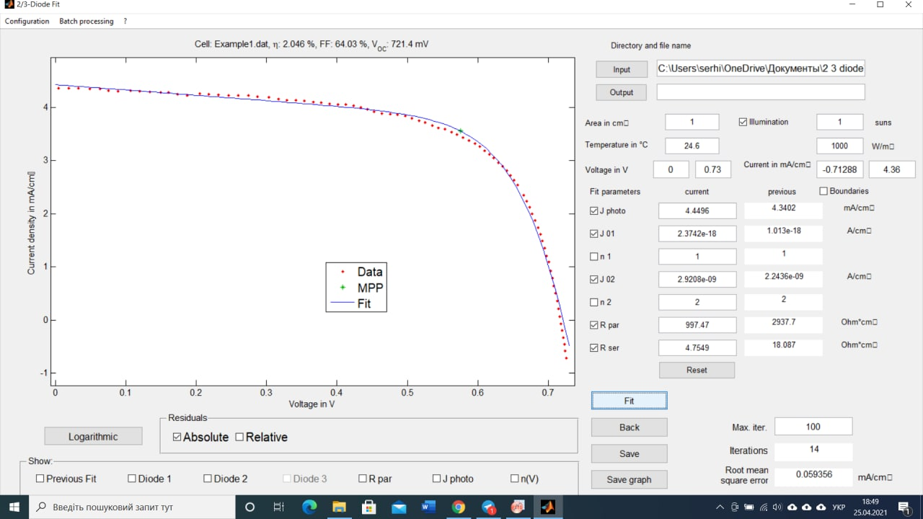
J-V measurements and simulations
Performing of the solar cell parameters simulations :
Open-circuit voltage, and short-circuit current
Power conversion efficiency
J-V and energy structure simulations
Serial resistance and fill factors
Parasitic shunt resistance
2/3 Diode Fit
1st Workshop Green Energy Technologies for the Future

Slide 22
Simulations of band diagram and parameters of solar cells
25
20
15
10
5
0
Position (nm)
0
10 20 30 40
Position (nm)
1st Workshop Green Energy Technologies for the Future

Slide 23

Fabrication of PEDOT:PSS thin films on silicon
30 - 50 nm
2000 rpm for 20 s
The native oxide on the Si surface was removed by hydrofluoric acid (5% HF for 30 s)
PEDOT:PSS
5 vol% DMSO and 0.025 % SDS were added to
the PEDOT:PSS solution
n-Si (001)
PEDOT:PSS was spin coated at 2000 rpm for 20 s and annealed at 140 °C for 30 min under standard atmospheric conditions
12 mm

Slide 24

Fabrication of PEDOT:PSS – Si photovoltaic cells
PEDOT:PSS
n-Si (001)
In/Ga eutectic back contact
A
B
0.35
0.18
1.5
8.0
9.0
1.0
1.0
(25 %)
(34 %)

Slide 25
PEDOT:PSS / n-Si(001) Schottky barrier
LUMO
LUMO
UPS: qφ_{p} = 4.8 ± 0.1 eV
E_{c}-E_{F} = 0.15 eV
HOMO
HOMO
n-Si
nearly ideal Schottky barrier height formation
PEDOT:PSS even induces a strong inversion
PEDOT n-Si
* To determine the barrier height at the n-Si/PEDOT:PSS junctions the the C-V dependence was investigated

Slide 26
IV and CV characterization of Au/PEDOT:PSS/n-Si
Au
PEDOT : PSS
n - Si
InGa

Slide 27
I-V characteristics under AM1.5 irradiation

Slide 28


2020 U.S.-Ukraine Alternative Energy Research Competition
Energy that can be used by a GeSn alloys
Compositional dependencies of the
direct and indirect bandgaps of GeSn
Si
Ge
GeSn
Ge_{1-x}Sn_{x}
Ge
Si substrate
Transparent conductive PEDOT:PSS
Ge_{1-x}Sn_{x} (direct bandgap 0.3 – 0.8 eV)
Ge (indirect bandgap 0.67 eV)
Si (indirect bandgap 1.12 eV)
1st Workshop Green Energy Technologies for the Future

Slide 29

Prof. Dr. Serhiy Kondratenko
Taras Shevchenko National University of Kyiv
Division of Optics
64/13, Volodymyrska Street, City of Kyiv, Ukraine, 01601
Kondratenko@knu.ua
Prof. Dr. Oleg Olikh
Taras Shevchenko National University of Kyiv
General Physics Department
64/13, Volodymyrska Street, City of Kyiv, Ukraine, 01601
olegolikh@knu.ua
Taras Shevchenko National University of Kyiv, 2023

